Slide 1
Chapter 12:
Using Controls

Slide 2
Objectives
Learn about Controls.
Examine the IDE’s automatically generated code.
Set a Control’s Font
Create a Form that contains a LinkLabel.
Add color to a Form.
Add CheckBox and RadioButton objects to a Form.
Add a PictureBox to a Form.

Slide 3
Objectives
Add ListBox, ComboBox, and CheckedListBox items to a Form.
Add a MonthCalendar and DateTimePicker to a Form.
Work with a Form’s layout.
Add a MenuStrip to a Form.
Learn to use other controls.

Slide 4
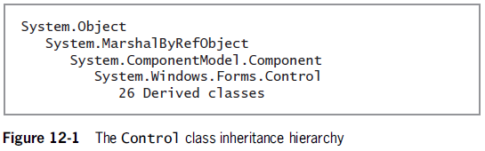
Understanding Controls
The Control class provides the definitions for GUI objects.
The Component class provides containment and cleanup for other objects – disposal of Controls when they are destroyed.

Slide 5
Examining the IDE’s Automatically Generated Code
A new Windows Forms project has been started and given the name FormWithALabelAndAButton.
A Label has been dragged onto Form1 and its properties have been updated.
A Button has been dragged onto Form1 and its properties have been updated.

Slide 6
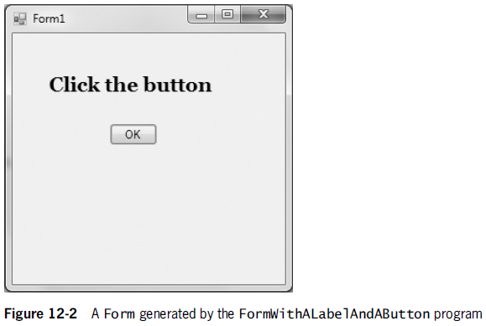
Examining the IDE’s Automatically Generated Code

Slide 7
Examining the IDE’s Automatically Generated Code
Within the Form1.Designer.cs file in Visual Studio, two lines of code are generated as follows:
private System.Windows.Forms.Label label1;
private System.Windows.Forms.Button okButton;
These lines appear under a gray box that contains Windows Form Designer generated code.
Expand the code generated by clicking the + in the method node or double-clicking the gray box.

Slide 8
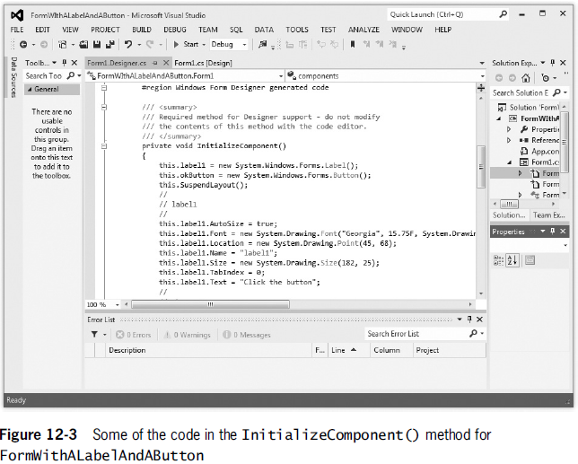
Examining the IDE’s Automatically Generated Code

Slide 9
Setting a Control’s Font
When designing a Control, it is easiest to select a Font from the Properties list found in the Properties Window.
You could also use the Font class to change the appearance of printed text on GUI Forms.
To do so, you would create your own instance of the Font class and include code like the following:
System.Drawing.Font bigFont = new System.Drawing.Font("Courier New", 16.5f);
this.label1.Font = bigFont;
this.okButton.Font = bigFont;

Slide 10
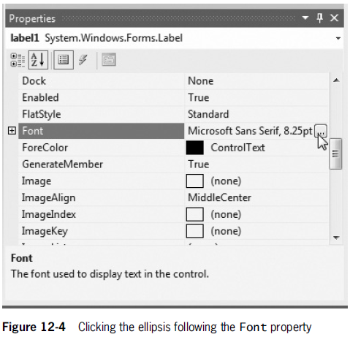
Setting a Control’s Font

Slide 11
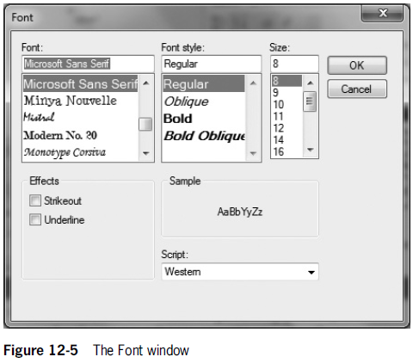
Setting a Control’s Font

Slide 12
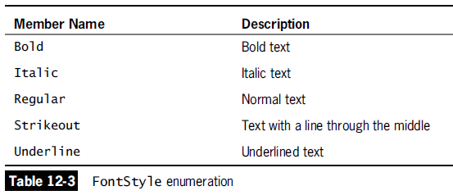
Setting a Control’s Font

Slide 13
Using a LinkLabel
A LinkLabel is similar to a Label because it is a child of Label.
However, it provides the additional capability to link the user to other sources – such as Web pages or files.
The default event for a Control is:
The method whose shell is automatically created when you double-click the Control.
The method you are most likely to alter when you use the Control.
The event that users most likely expect to generate when they encounter the Control in a working application.

Slide 14
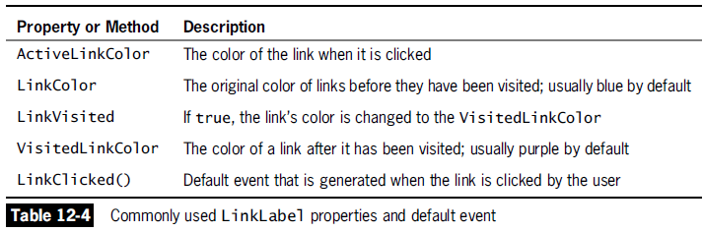
Using a LinkLabel

Slide 15
Using a LinkLabel
A LinkLabel appears as underlined text – the text is blue by default.
When you pass the mouse pointer over a LinkLabel, the pointer changes to a hand.
When a user clicks a LinkLabel, it generates a click event that executes the associated LinkClicked() method.
The LinkVisited property can be set to true when you determine that a user has clicked a link.

Slide 16
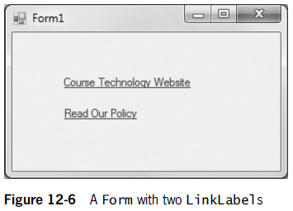
Using a LinkLabel

Slide 17
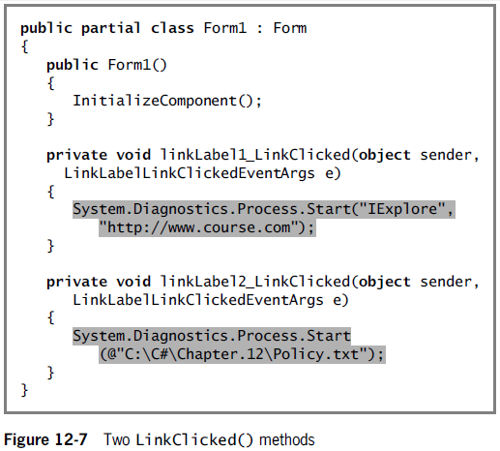
Using a LinkLabel

Slide 18
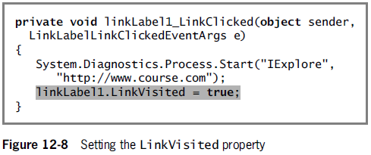
Using a LinkLabel

Slide 19
Adding Color to a Form
The color class contains a wide variety of predefined colors that you can use with the Controls on a Form.
You can change a Form’s color using its BackColor and ForeColor properties.
this.label1.BackColor = System.Drawing.Color.Blue;
this.label1.ForeColor = System.Drawing.Color.Gold;

Slide 20
Using CheckBox and RadioButton Objects
A CheckBox object is GUI widget that allows the user to select or deselect an option with a click.
When a Form contains multiple CheckBoxes, any number of them can be checked or unchecked at the same time.
RadioButtons are similar to CheckBoxes except for the fact that only one RadioButton in a group can be selected at a time.
Selecting one RadioButton automatically deselects the others.

Slide 21
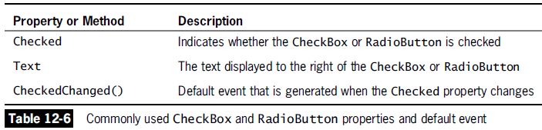
Using CheckBox and RadioButton Objects

Slide 22
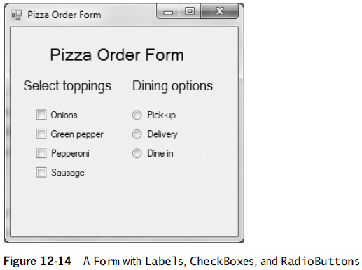
Using CheckBox and RadioButton Objects

Slide 23
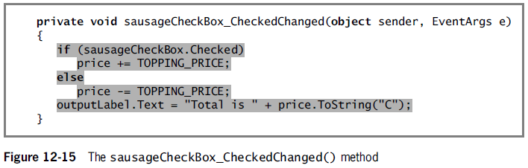
Using CheckBox and RadioButton Objects

Slide 24
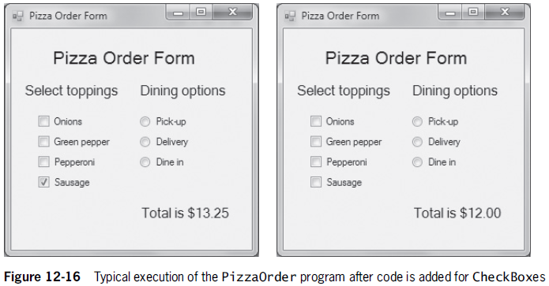
Using CheckBox and RadioButton Objects

Slide 25
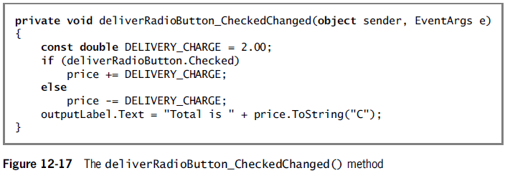
Using CheckBox and RadioButton Objects

Slide 26
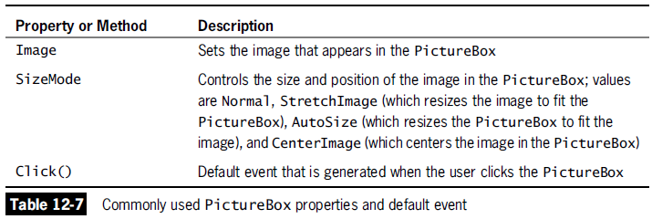
Adding a PictureBox to a Form
A PictureBox is a Control in which you can display graphics from a bitmap, icon, JPEG, GIF, or other type of image file.

Slide 27
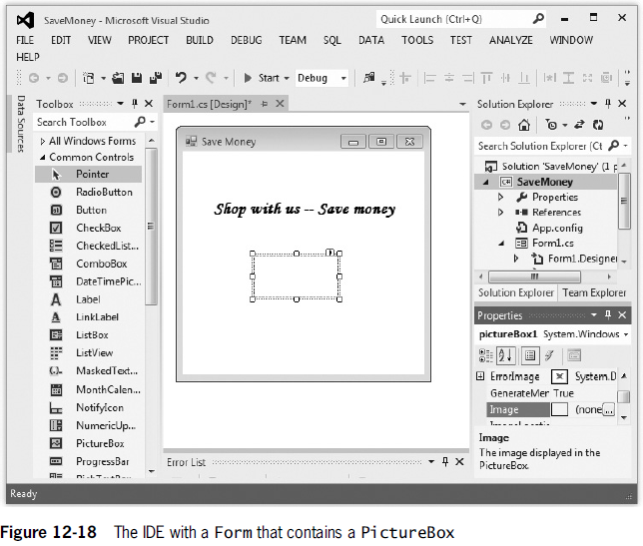

Slide 28
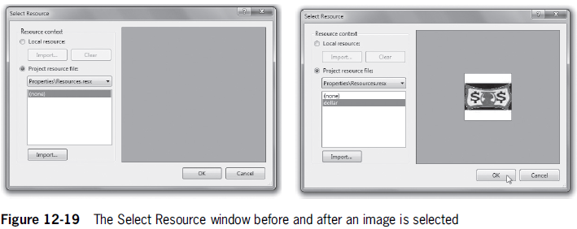
Adding a PictureBox to a Form

Slide 29
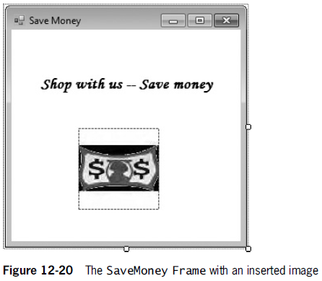
Adding a PictureBox to a Form

Slide 30
Adding ListBox, CheckedListBox, and ComboBox Controls to a Form
ListBox, ComboBox, and CheckedListBox objects all allow users to select choices from a list.
These list-type widgets descend from ListControl.
A ListBox Control displays a list of items the user can select by clicking.
The user can make a single selection or multiple selections by setting the SelectionMode property.
The SelectedItem property contains the value of the item a user has selected.

Slide 31
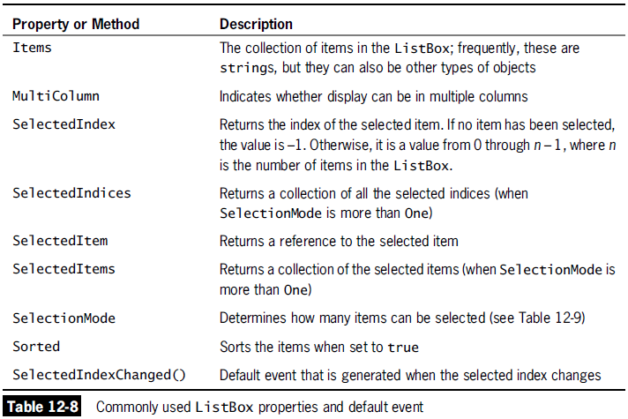
Adding ListBox, CheckedListBox, and ComboBox Controls to a Form

Slide 32
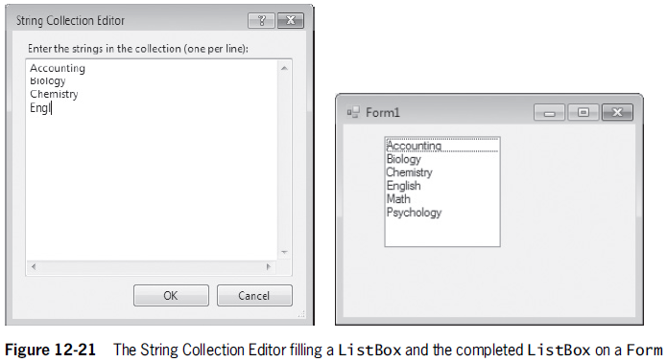
Adding ListBox, CheckedListBox, and ComboBox Controls to a Form

Slide 33
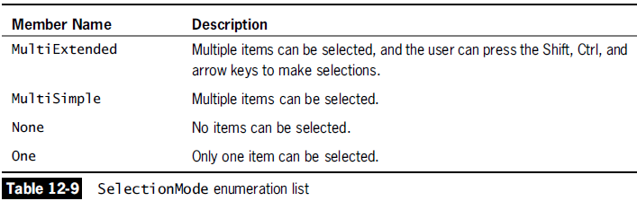
Adding ListBox, CheckedListBox, and ComboBox Controls to a Form

Slide 34
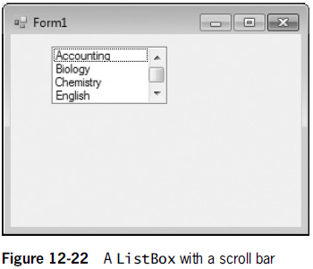
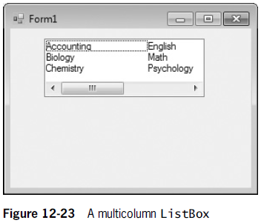
Adding ListBox, CheckedListBox, and ComboBox Controls to a Form

Slide 35
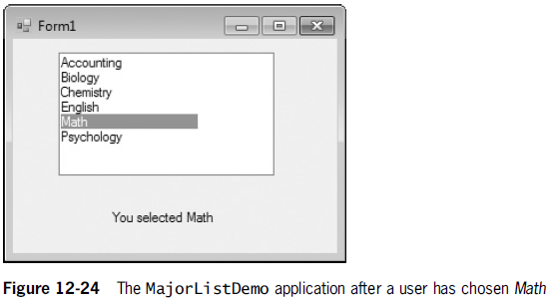
Adding ListBox, CheckedListBox, and ComboBox Controls to a Form

Slide 36
Adding ListBox, CheckedListBox, and ComboBox Controls to a Form
A ComboBox Control is similar to a ListBox except for the fact that it displays an additional editing field.
A ComboBox allows the user to select an item from the list or enter new text in the editing field.
A CheckedListBox Control is also similar to a ListBox except for the fact that check boxes appear to the left of each item in the list.

Slide 37
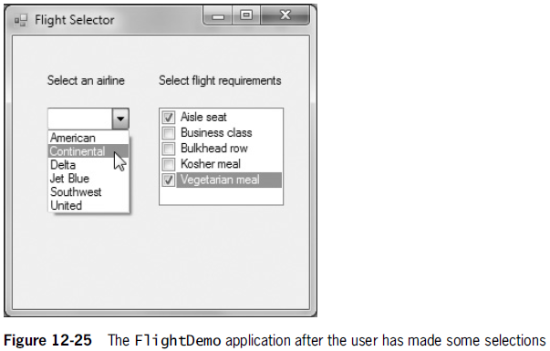
Adding ListBox, CheckedListBox, and ComboBox Controls to a Form

Slide 38
Adding MonthCalendar and DateTimePicker Controls to a Form
The MonthCalendar and DateTimePicker Controls allow you to retrieve date and time information.
When you use the MonthCalendar, the current date is contained in a rectangle by default, and the date that the user clicked is shaded.

Slide 39
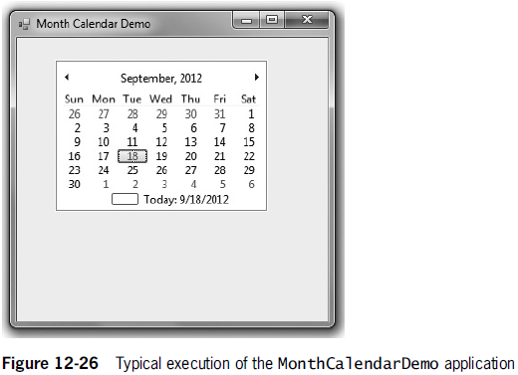
Adding MonthCalendar and DateTimePicker Controls to a Form

Slide 40
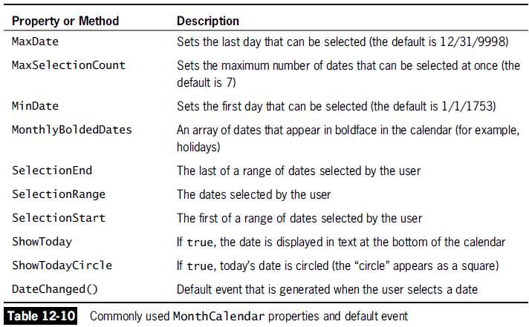
Adding MonthCalendar and DateTimePicker Controls to a Form

Slide 41
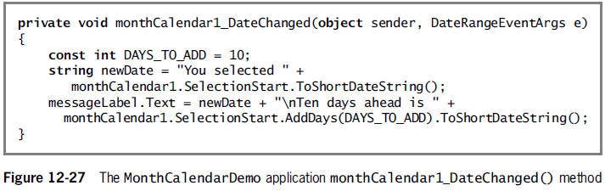
Adding MonthCalendar and DateTimePicker Controls to a Form

Slide 42
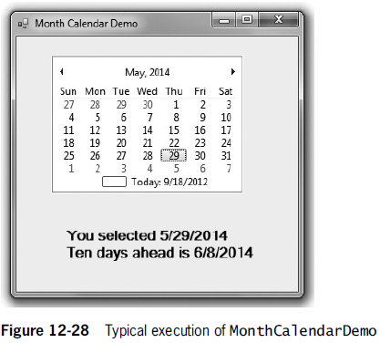
Adding MonthCalendar and DateTimePicker Controls to a Form

Slide 43
Adding MonthCalendar and DateTimePicker Controls to a Form
The DateTimePicker Control displays a month calendar when the down arrow is selected.
When you use the CustomFormat property, the date displayed in a DateTimePicker Control is more customizable than the one in a MonthCalendar.

Slide 44
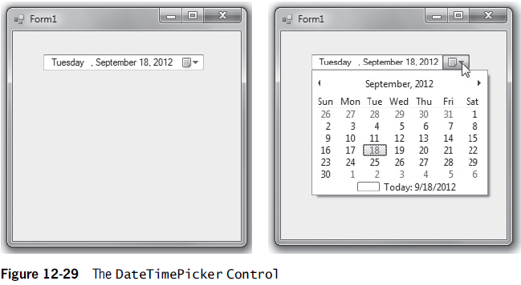
Adding MonthCalendar and DateTimePicker Controls to a Form

Slide 45
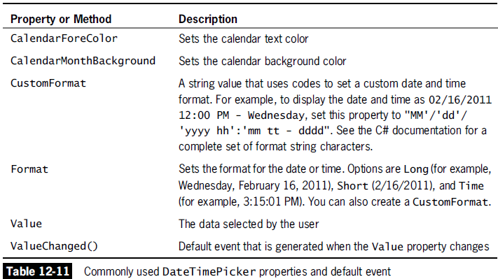
Adding MonthCalendar and DateTimePicker Controls to a Form

Slide 46
Working with a Form’s Layout
When you drag multiple Controls onto a Form, blue snap lines appear to help you align new Controls with others already in place.
They also appear when you place a Control closer to the edge of a container than is recommended.

Slide 47
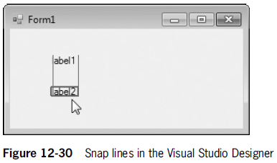
Working with a Form’s Layout

Slide 48
Working with a Form’s Layout
The Anchor property causes a Control to remain at a fixed distance from the side of a container when the user resizes it.
The Dock property attaches a Control to the side of a container so that the Control stretches when the container’s size is adjusted.
The Padding property specifies the distance between docked Controls and the edges of the Form.

Slide 49
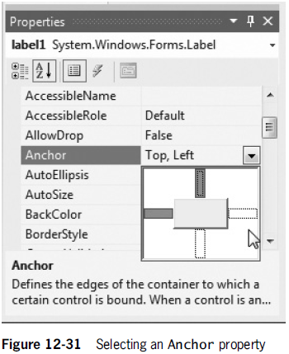
Working with a Form’s Layout

Slide 50
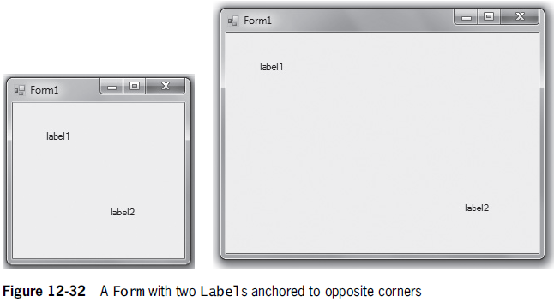
Working with a Form’s Layout

Slide 51
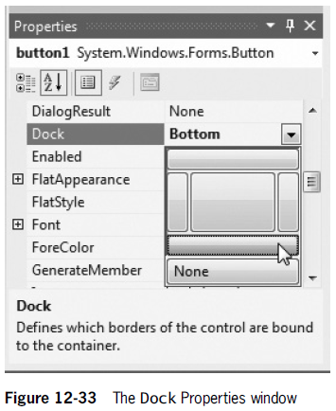
Working with a Form’s Layout

Slide 52
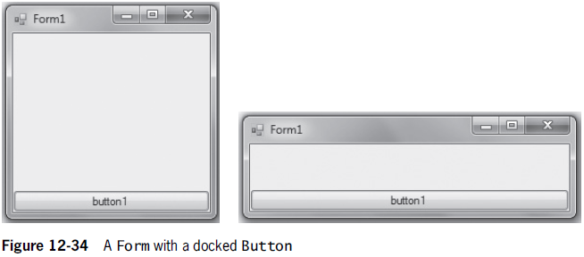
Working with a Form’s Layout

Slide 53
Understanding GroupBoxes and Panels
A GroupBox or a Panel can be used to group related Controls on a Form.
They can be anchored or docked inside a Form.
GroupBoxes can display a caption, but never have scroll bars.
Panels cannot display a caption, but have scroll bars.

Slide 54
Adding a MenuStrip to a Form
A menu strip is a horizontal list of general options that appear under the title bar of a Form or Window.
You can add a MenuStrip Control object to any Form you create.
When you double-click an entry in a MenuStrip, a Click() event method is generated.

Slide 55
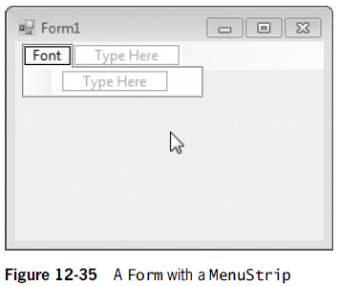
Adding a MenuStrip to a Form

Slide 56
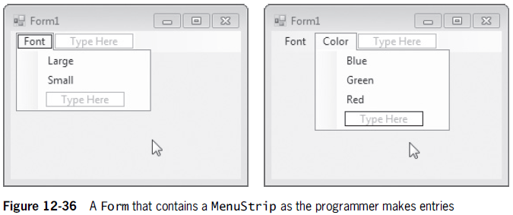
Adding a MenuStrip to a Form

Slide 57
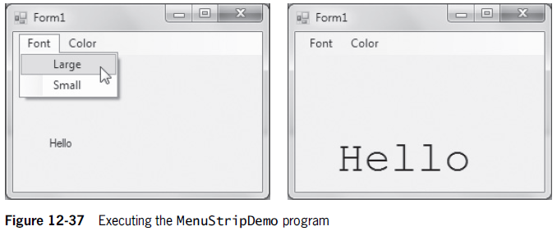
Adding a MenuStrip to a Form

